Slide 1
Follow up from 4_analysis
Solutions for questions I couldn’t answer during class
7/19/23

Slide 2
Question 1: how can I acess linear regression from the menus?

Slide 3
Step 1: go to Statistics → Linear models and related → Linear regression

Slide 4
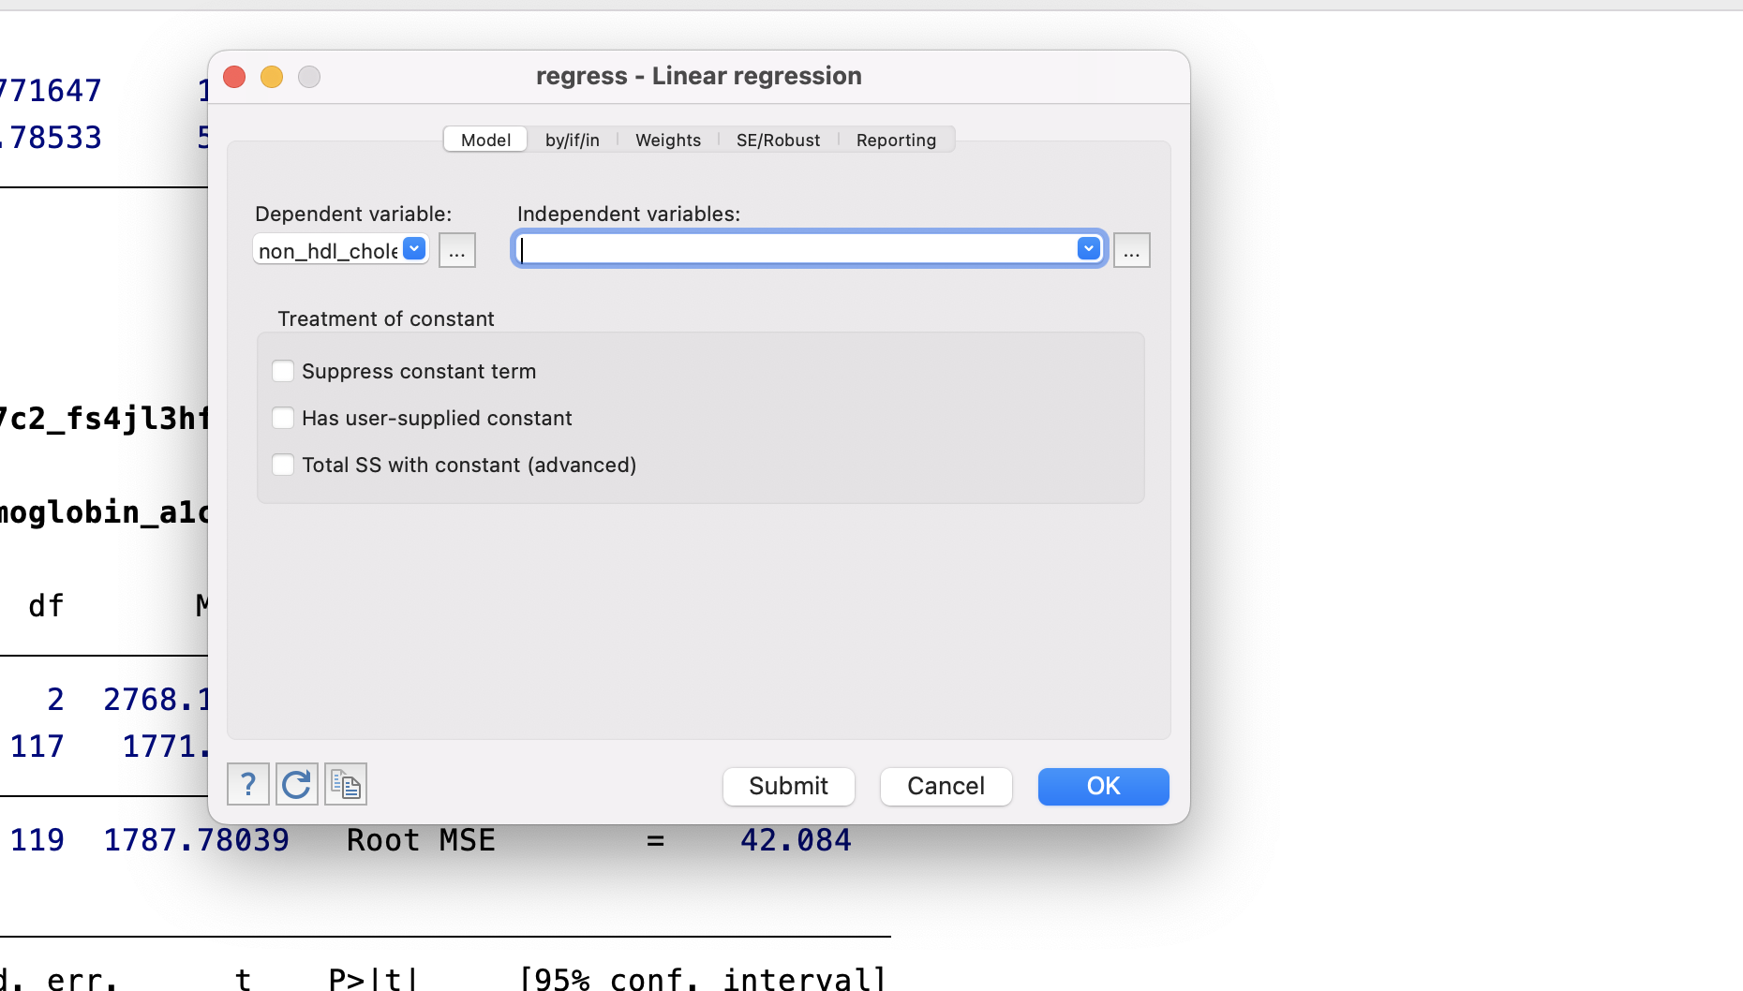
Step 2: fill in your y variable then click the … by “independent variables”

Slide 5
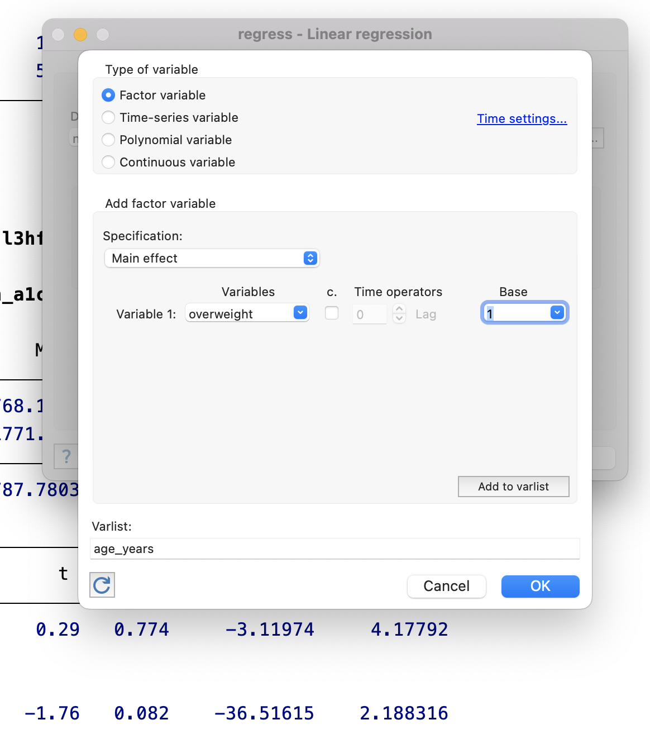
Step 3: put your first variable. Can change the base/reference level from here. Click “add to varlist”

Slide 6
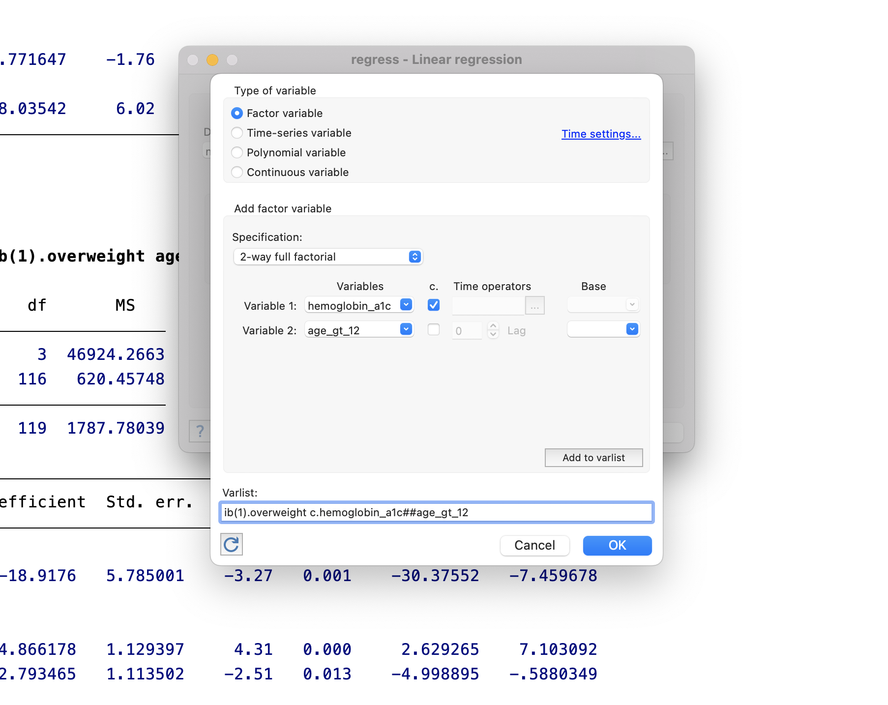
Step 4: if you want an interaction with main effects, select 2-way interaction and put the variables in. Click “add to varlist” and then “ok”

Slide 7
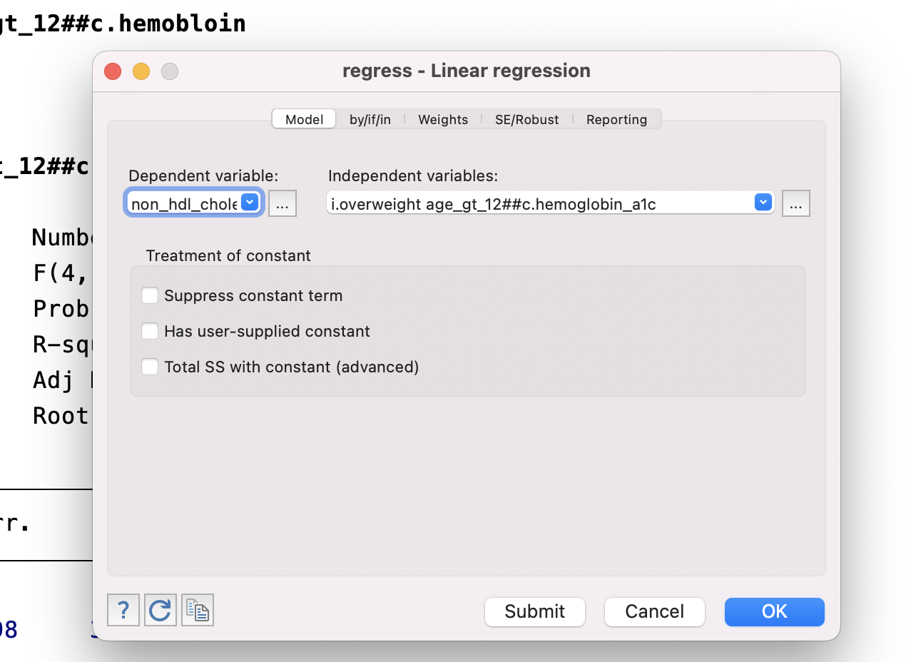
Step 5: click “ok” one more time

Slide 8
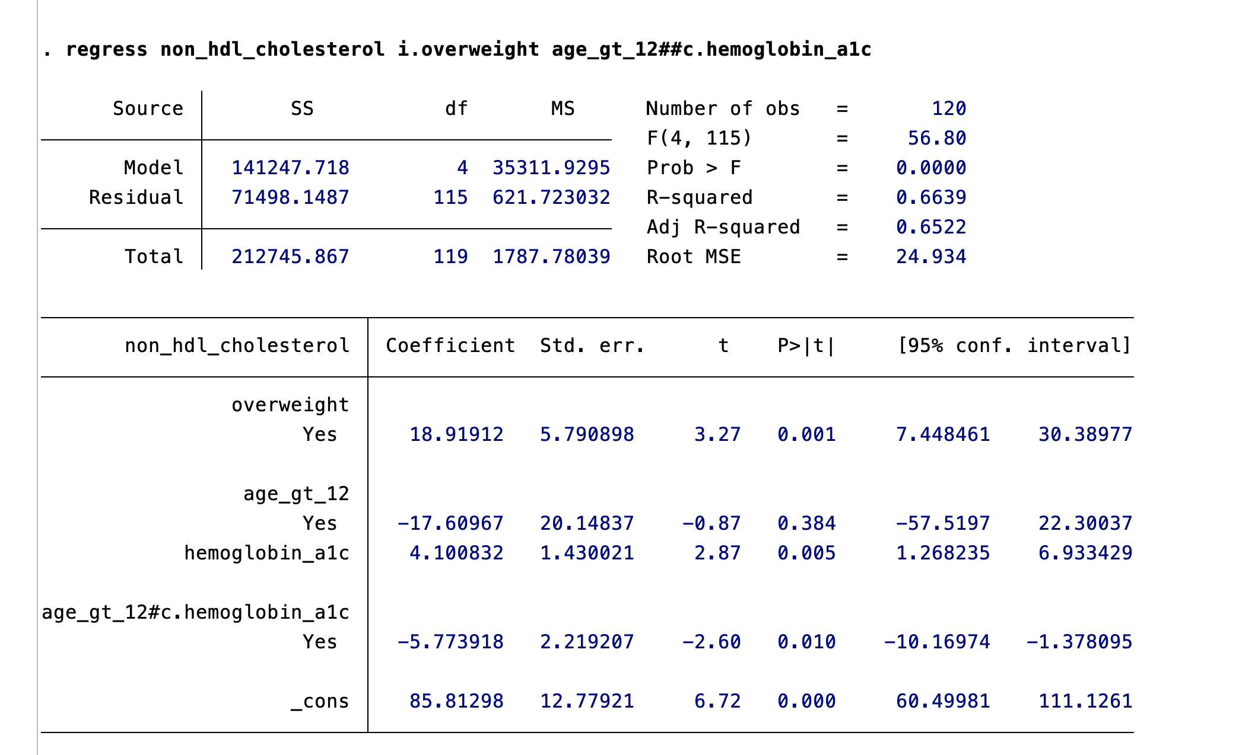

Slide 9
Question 2: how can I change the reference level for a variable in a regression?

Slide 10
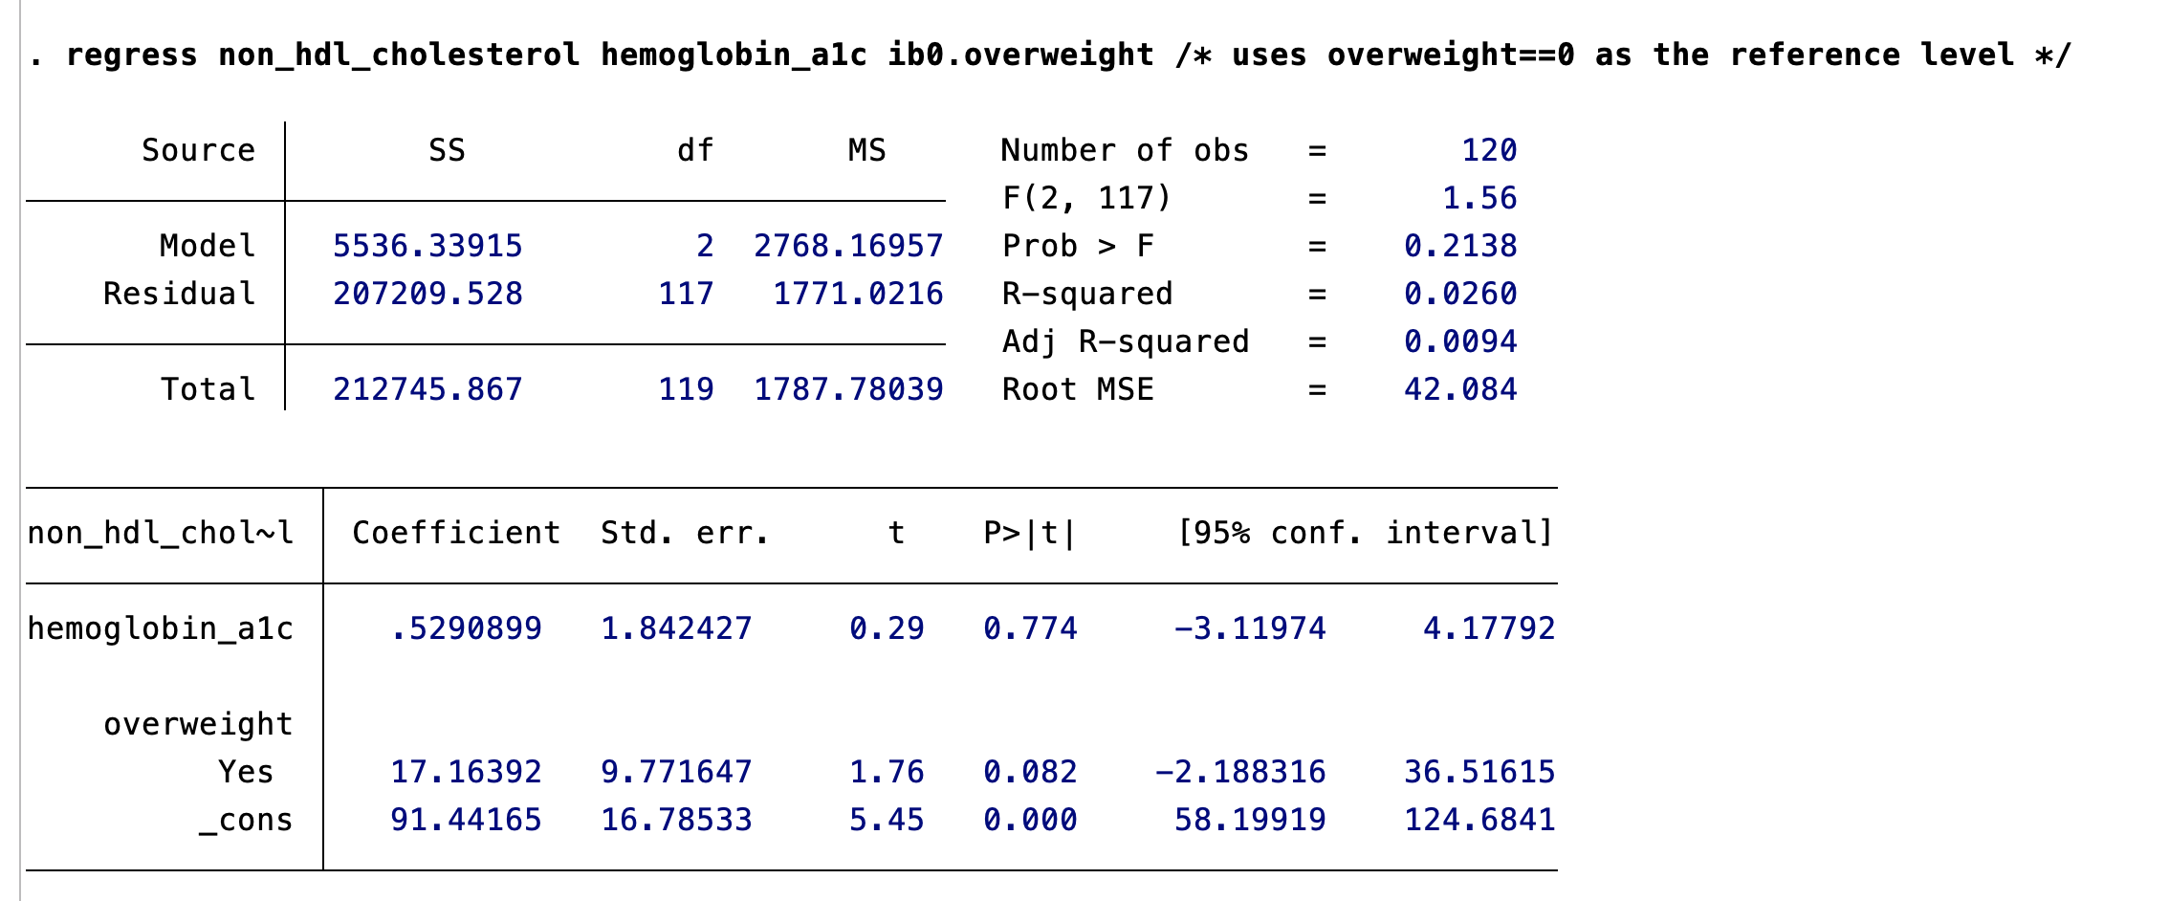
Use ib#.variable, as below

Slide 11
